Slide 1
"World Economic Indicator: Analyzing Factors for Sustainable Growth"
-A Data-Driven Approach to Identify Key Economic Growth Factors

Slide 2
Content
Problem statement
Methodology used
Various features used
Executive summary
Visualization
Bivariate analysis
Univariate analysis

Slide 3
Problem Statement:
"The Organisation for Economic Co-operation and Development (OECD) is creating a new department to focus on how countries can achieve sustainable economic growth. As a data analyst for this department, your task is to analyze various factors that influence GDP per capita using the World Economic Indicator dataset."

Slide 4
Methodology used ..
Data Preparation:
Rearranged columns in all sheets to bring common columns to the front
Created a unique ID using the concatenation of the country/region and year features.
Handling Missing Values:
Evaluated different methods (leave as is, delete rows, data imputation).
Chose data imputation due to the high number of missing values and their potential impact on analysis.
Replaced missing values with average values because the standard deviation was significantly smaller than the average.
Outlier Detection:
Identified outliers in key columns such as GDP per capita, CO2 Emission per capita, Energy consumption per capita, and Tourism outbound per capita using quartile functions and min-max analysis.

Slide 5
Feature Engineering:
Created new features like GDP per capita, CO2 Emission per capita, Energy consumption per capita, and Tourism outbound per capita to enrich the dataset.
Data Analysis:
Conducted univariate and bivariate analyses on both existing and new features to gain insights into factors affecting GDP per capita

Slide 6
Various features used
unique id : created by concatenation of Country/Region feature and Year feature
Country/Region
Region
Year
GDP
Health Exp % GDP
Health Exp/Capita
Lending Interest
Energy Usage
CO2 Emissions
Birth Rate
Infant Mortality Rate
Life Expectancy Female
Life Expectancy Male
Population 0-14
Population 15-64
Population 65+

Slide 7
Various features used continued….
Population Total
Population Urban
Tourism Inbound
Tourism Outbound
Business Tax Rate
Days to Start Business
Days to Start Business
Hours to do Tax
Internet Usage
Mobile Phone Usage
gdp/capita
CO2 Emission/capita
Energy consumption/capita
tourism outbound/ capita
Business Tax Rate
Days to Start Business
Ease of Business
Hours to do Tax
Internet Usage

Slide 8
Various features used continued….
Mobile Phone Usage
gdp/capita
CO2 Emission/capita
Energy consumption/capita
tourism outbound/ capita

Slide 9
Executive summary
This project aims to analyze the World Economic Indicator dataset to determine the key factors that countries should focus on to achieve sustainable GDP per capita growth."
past 12 year data was considered for the data analysis process
By doing the data analysis we found out :
1) GDP with GDP/CAPITA
After analyzing the data of GDP with GDP/CAPITA we can see that there is a positive correlation where gdp/capita Increases when GDP increases
2) Health Exp % GDP vs gdp/capita
After analyzing the data of Health Exp % GDP with gdp/capita
we can see that there is a negative correlation where gdp/capita decreases when Health Exp % GDP increases

Slide 10
3)Health Exp/Capita vs gdp/capita
After analyzing the data of Health Exp/Capita with gdp/capita
we can see that there is a positive correlation where gdp/capita Increases Health Exp/Capita increases
4)Lending Interest vs gdp/capita
After analyzing the data of Lending Interest with gdp/capita
we can see that there is a negative correlation where gdp/capita decreases when Lending Interest Increases
5) Energy Usage vs gdp/capita
After analyzing the data of Energy usage with gdp/capita
we can see that there is a positive correlation where gdp/capita Increases Energy Usage increases
6)CO2 Emissions vs gdp/capita
After analyzing the data of CO2 Emissions with gdp/capita
we can see that there is a negative correlation where gdp/capita decreases when Lending Interest Increases

Slide 11
7)Birth Rate vs gdp/capita
After analyzing the data of Birth Rate with gdp/capita
we can see that there is a negative correlation where gdp/capita decreases when Birth Rate Increases
8)Infant Mortality Rate vs gdp/capita
After analyzing the data of Infant Mortality Rate with gdp/capita
we can see that there is a negative correlation where gdp/capita decreases when Infant Mortality Rate Increases
9)Life Expectancy Female vs gdp/capita
After analyzing the data of Life Expectancy Female with gdp/capita
we can see that there is a positive correlation where gdp/capita Increases when Life Expectancy Female increases
10)Life Expectancy Male vs gdp/capita
After analyzing the data of Life Expectancy male with gdp/capita
we can see that there is a positive correlation where gdp/capita Increases when Life Expectancy male increases

Slide 12
11)Population 0-14 vs gdp/capita
After analyzing the data of Population 0-14 with gdp/capita
we can see that there is a negative correlation where gdp/capita decreases when Population 0-14 Increases
12)Population 15-64 vs gdp/capita
After analyzing the data of Population 15-64 with gdp/capita
we can see that there is a positive correlation where gdp/capita Increases when Population 15-64 increases
13)Population 65+ vs gdp/capita
After analyzing the data of Population 65+with gdp/capita
we can see that there is a positive correlation where gdp/capita Increases when Population 65+ increases

Slide 13
14)Population Total vs gdp/capita
After analyzing the data of Population Total with gdp/capita
we can see that there is a negative correlation where gdp/capita decreases when Population Total Increases
15)Population Urban vs gdp/capita
After analyzing the data of Population urban with gdp/capita
we can see that there is a positive correlation where gdp/capita Increases when Population urban increases
16)Tourism Inbound vs gdp/capita
After analyzing the data of Tourism inbound with gdp/capita
we can see that there is a negative correlation where gdp/capita decreases when Tourism Inbound increases
17)Tourism Outbound vs gdp/capita
After analyzing the data of Tourism outbound with gdp/capita
we can see that there is a negative correlation where gdp/capita decreases when Tourism outbound increases

Slide 14
18)Ease of Business vs gdp/capita
After analyzing the data of Ease of Business with gdp/capita
we can see that there is a negative correlation where gdp/capita decreases when Ease of Business increases
19)Hours to do Tax vs gdp/capita
After analyzing the data of Hours to do Tax with gdp/capita
we can see that there is a negative correlation where gdp/capita decreases when Hours to do Tax increases
20)Internet Usage vs gdp/capita
After analyzing the data of Internet Usage with gdp/capita
we can see that there is a positive correlation where gdp/capita Increases when Internet Usage increases
21)Mobile Phone Usage vs gdp/capita
After analyzing the data of Mobile Phone Usage with gdp/capita
we can see that there is a positive correlation where gdp/capita Increases when Mobile Phone Usage increases

Slide 15
22) CO2 Emission/capita vs gdp/capita
After analyzing the data of Mobile Phone Usage with gdp/capita
we can see that there is a positive correlation where gdp/capita Increases when Mobile Phone Usage increases
23)Energy consumption/capita vs gdp/capita
After analyzing the data of Mobile Phone Usage with gdp/capita
we can see that there is a positive correlation where gdp/capita Increases when Mobile Phone Usage increases
24) tourism outbound/ capita vs gdp/capita
After analyzing the data of Mobile Phone Usage with gdp/capita
we can see that there is a positive correlation where gdp/capita Increases when Mobile Phone Usage increases
25) Business Tax Rate vs gdp/capita
After analyzing the data of Business Tax Rate with gdp/capita
we can see that there is a negative correlation where gdp/capita decreases when Business Tax Rate increases

Slide 16
26) Days to Start Business vs gdp/capita
After analyzing the data of Days to Start Business with gdp/capita
we can see that there is a negative correlation where gdp/capita decreases when Days to Start Business increases

Slide 17
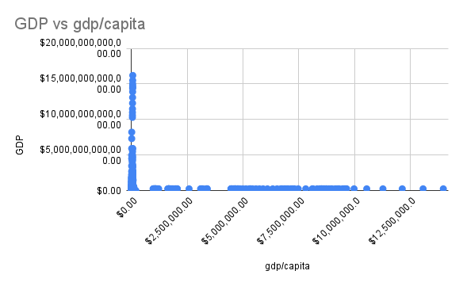
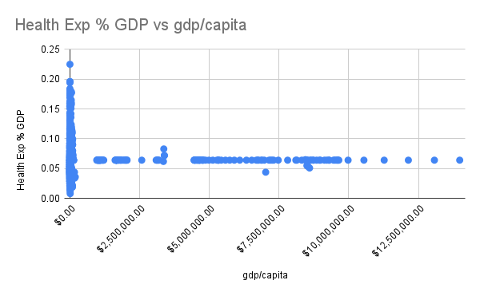
Visualisation
Bivariate analysis
we can see that there is a positive correlation where gdp/capita Increases when GDP increases
we can see that there is a negative correlation where gdp/capita decreases when Health Exp % GDP increases

Slide 18
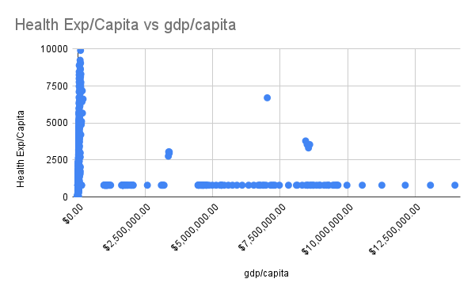
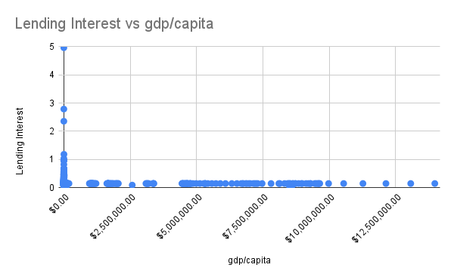
we can see that there is a positive correlation where gdp/capita Increases Health Exp/Capita increases
we can see that there is a negative correlation where gdp/capita decreases when Lending Interest Increases

Slide 19
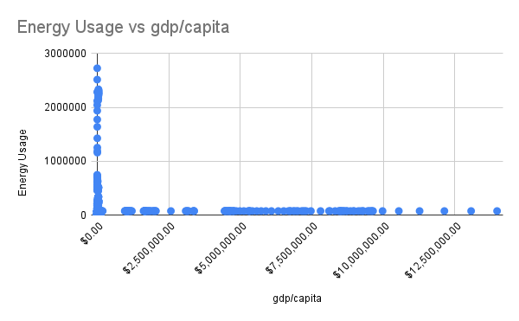
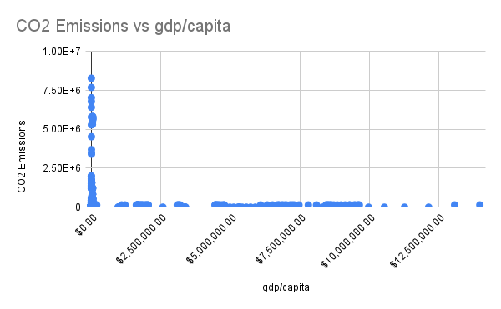
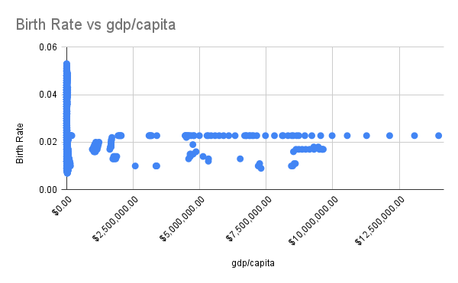
we can see that there is a positive correlation where gdp/capita Increases Energy Usage increases
we can see that there is a negative correlation where gdp/capita decreases when Lending Interest Increases
we can see that there is a negative correlation where gdp/capita decreases when Birth Rate Increases

Slide 20
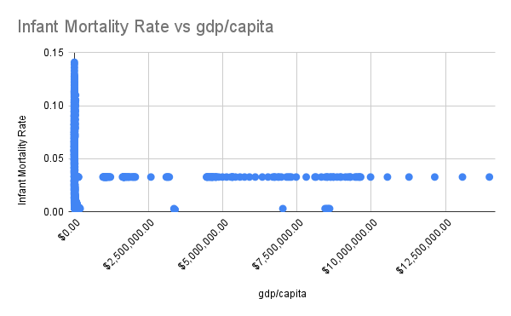
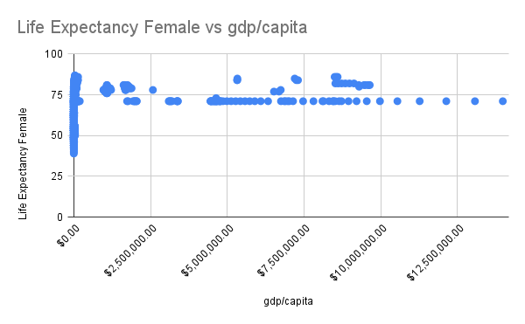
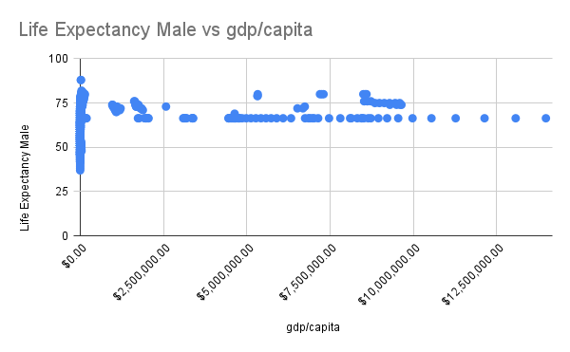
we can see that there is a negative correlation where gdp/capita decreases when Infant Mortality Rate Increases
we can see that there is a positive correlation where gdp/capita Increases when Life Expectancy Female increases
we can see that there is a positive correlation where gdp/capita Increases when Life Expectancy male increases

Slide 21
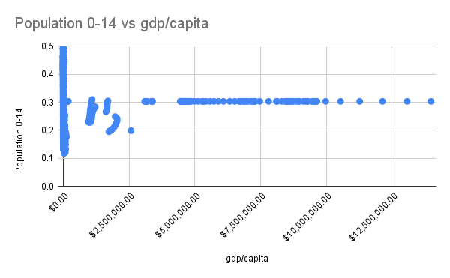
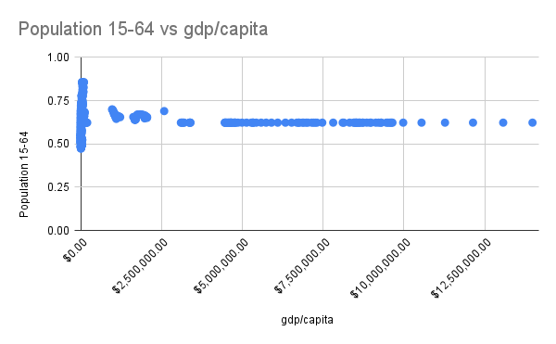
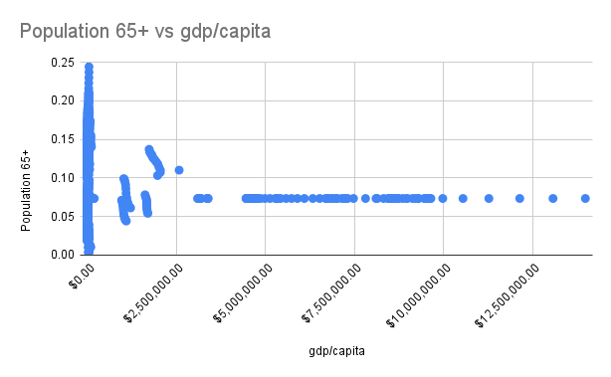
we can see that there is a negative correlation where gdp/capita decreases when Population 0-14 Increases
we can see that there is a positive correlation where gdp/capita Increases when Population 15-64 increases
we can see that there is a positive correlation where gdp/capita Increases when Population 65+ increases

Slide 22
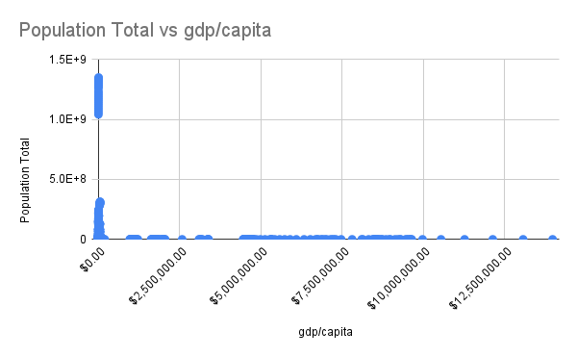
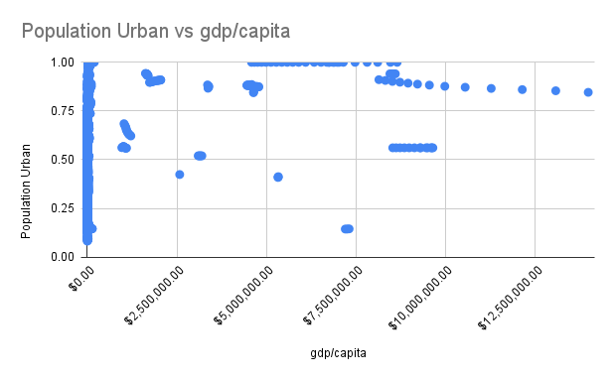
we can see that there is a negative correlation where gdp/capita decreases when Population Total Increases
we can see that there is a positive correlation where gdp/capita Increases when Population urban increases

Slide 23
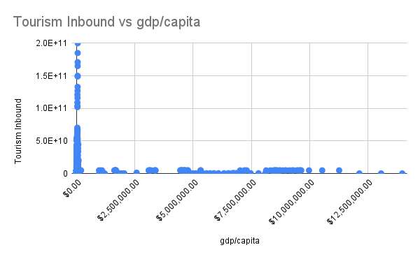
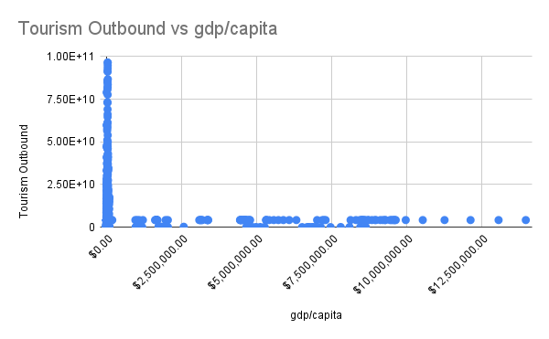
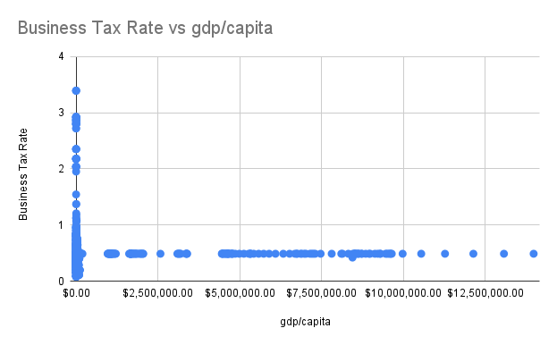
we can see that there is a negative correlation where gdp/capita decreases when Tourism Inbound increases
we can see that there is a negative correlation where gdp/capita decreases when Tourism outbound increases
we can see that there is a negative correlation where gdp/capita decreases when Business Tax Rate increases

Slide 24
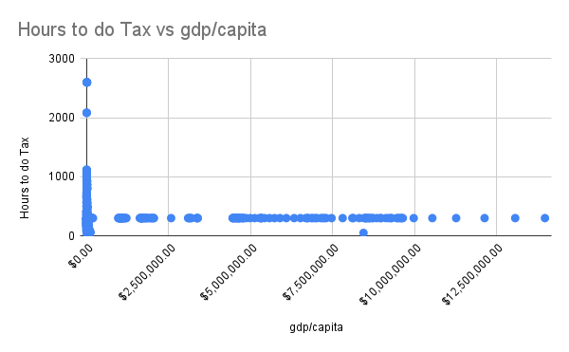
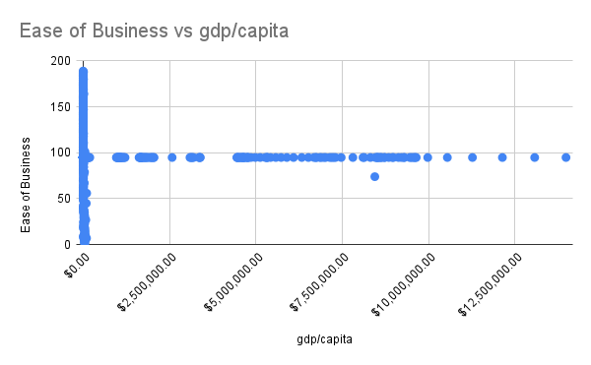
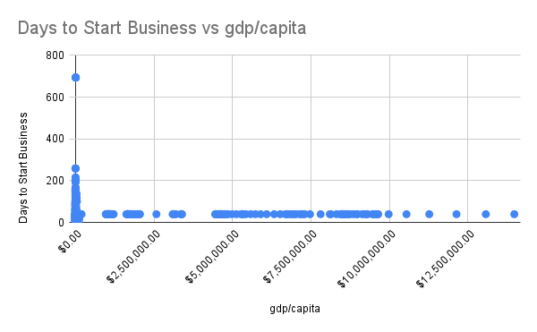
we can see that there is a negative correlation where gdp/capita decreases when Hours to do Tax increases
we can see that there is a negative correlation where gdp/capita decreases when Ease of Business increases
we can see that there is a negative correlation where gdp/capita decreases when Days to Start Business increases

Slide 25
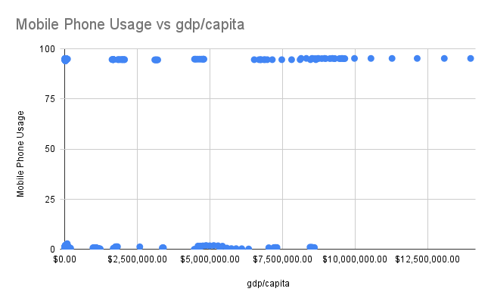
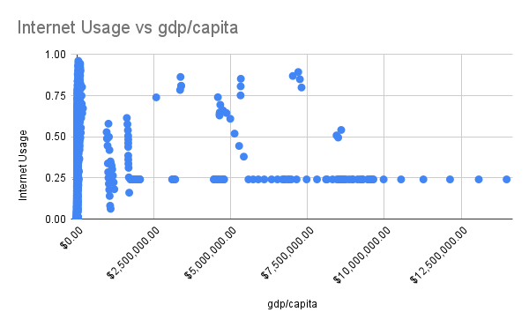
we can see that there is a positive correlation where gdp/capita Increases when Mobile Phone Usage increases
we can see that there is a positive correlation where gdp/capita Increases when Internet Usage increases

Slide 26
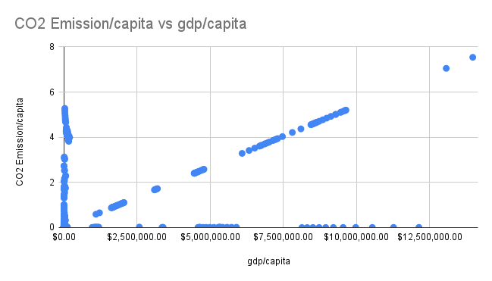
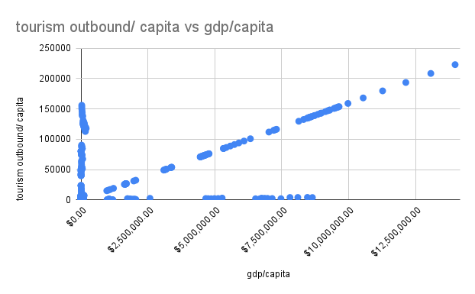
Feature engineering :features
we can see that there is a positive correlation where gdp/capita Increases when Mobile Phone Usage increases
we can see that there is a positive correlation where gdp/capita Increases when Mobile Phone Usage increases

Slide 27
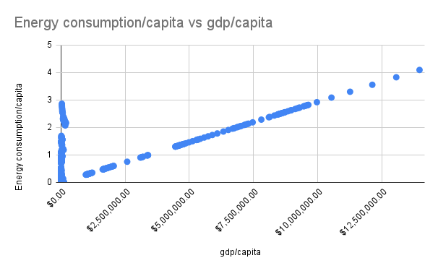
we can see that there is a positive correlation where gdp/capita Increases when Mobile Phone Usage increases

Slide 28
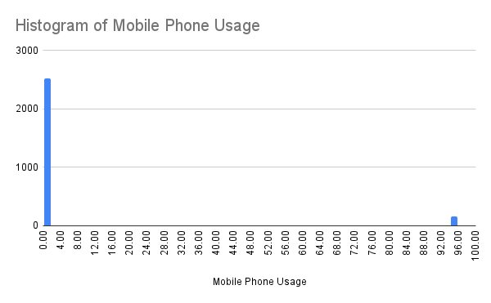
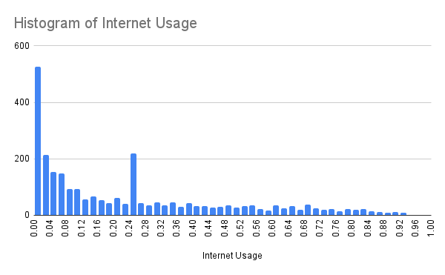
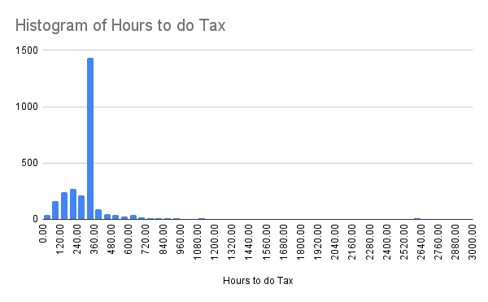
Univariate analysis

Slide 29
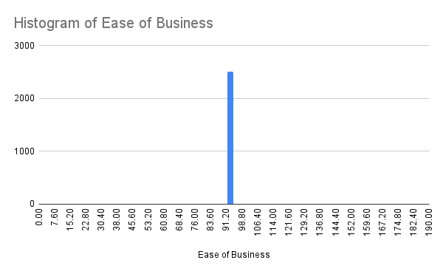
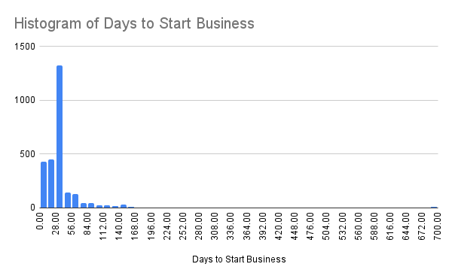
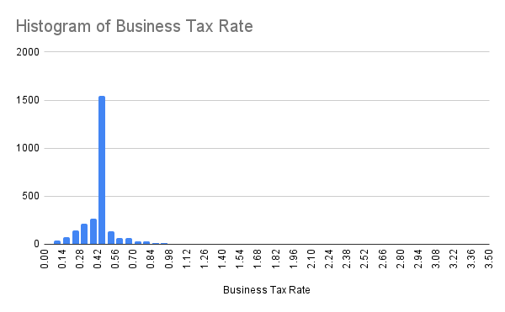

Slide 30
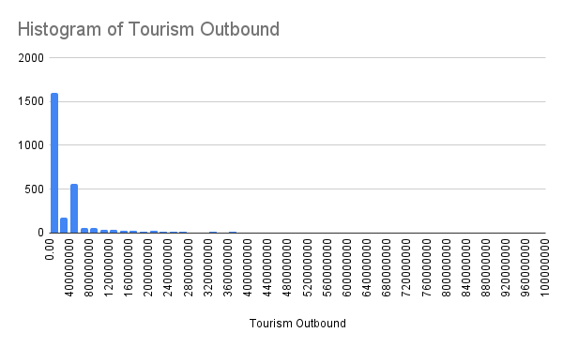
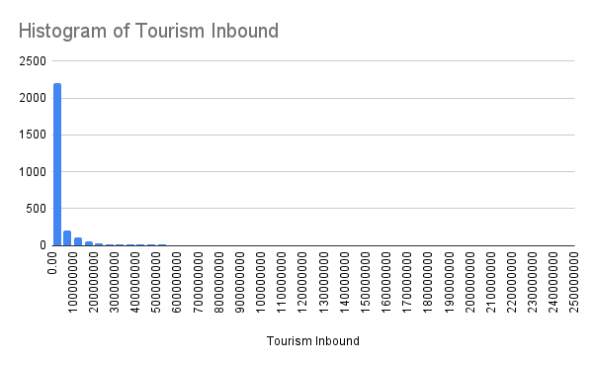
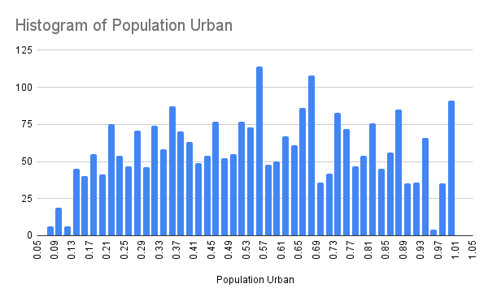

Slide 31
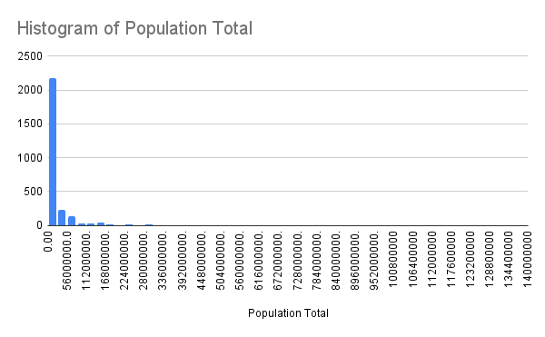
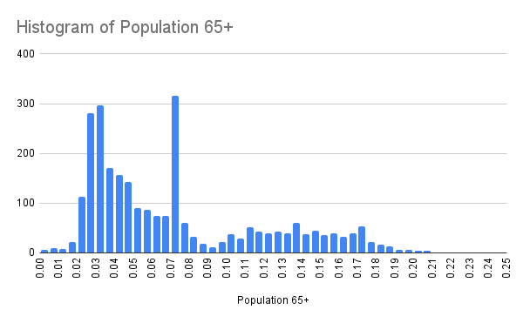
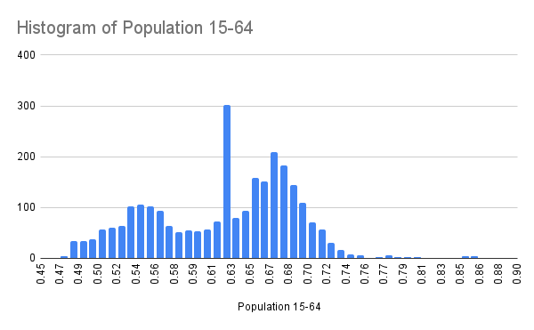

Slide 32
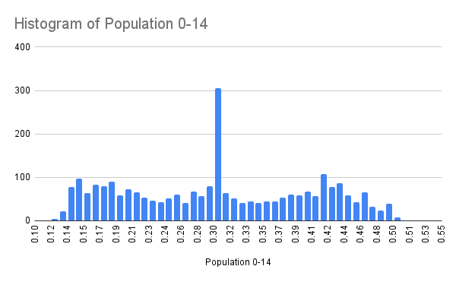
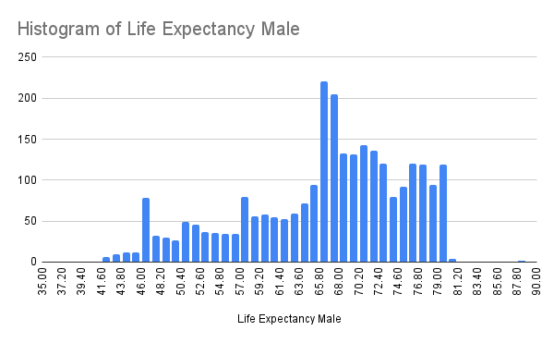
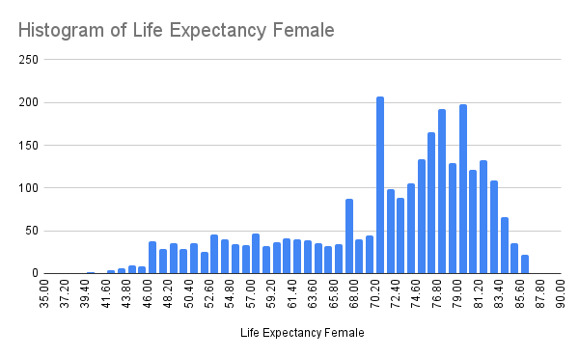

Slide 33
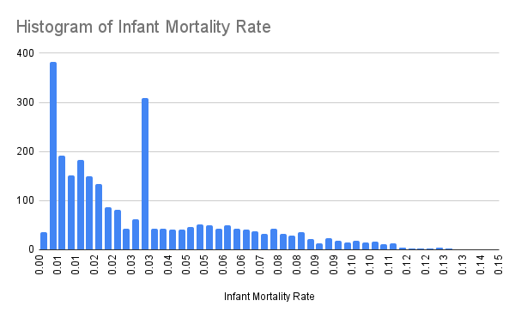
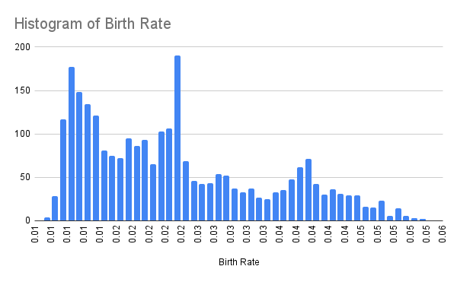
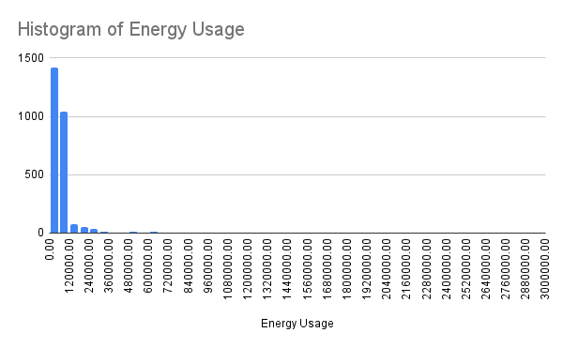

Slide 34
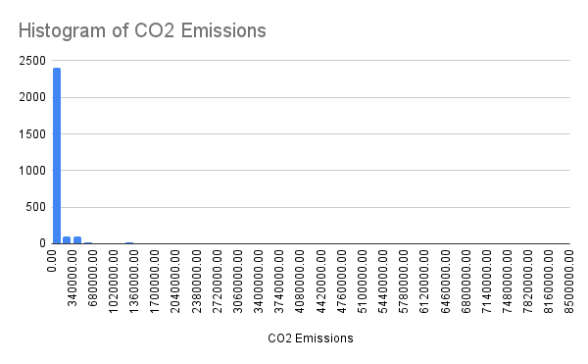
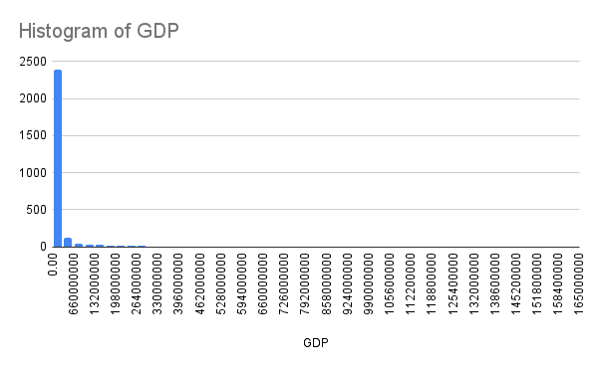
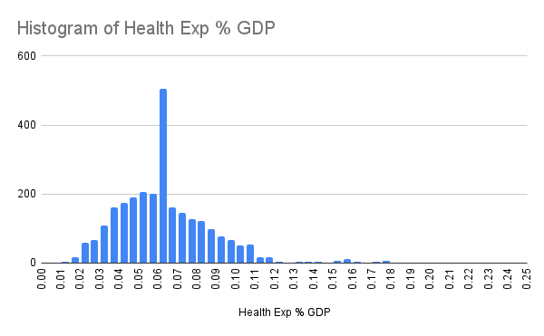

Slide 35
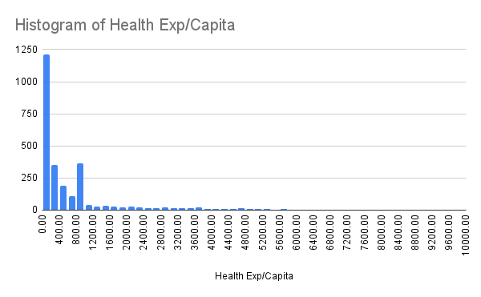
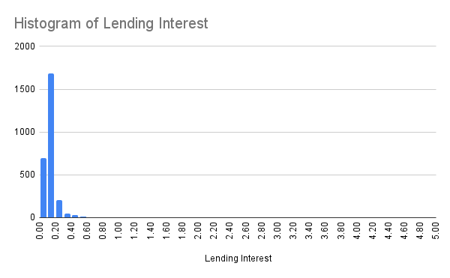

Slide 36
Thank you

